Slide 1



PHINCON
PROPERTY
BY FAHMI EFENDY

Slide 2




FAHMI EFENDY
Pademangan, Jakarta Utara
Universitas Bina Nusantara Bandung
Computer Science
PHINCON PROPERTY

Slide 3











TECH STACK
FRONT END
BACK END
DATABASE
PHINCON PROPERTY

Slide 4

List of Feature
01
Authentication
02
Browse House
03
Favorite
04
Appointment
05
Chatting
PHINCON PROPERTY

Slide 5
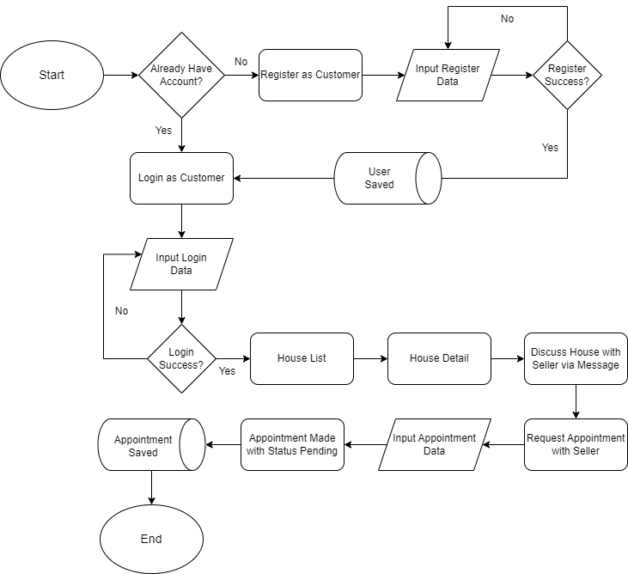
Customer
Flowchart
PHINCON PROPERTY

Slide 6
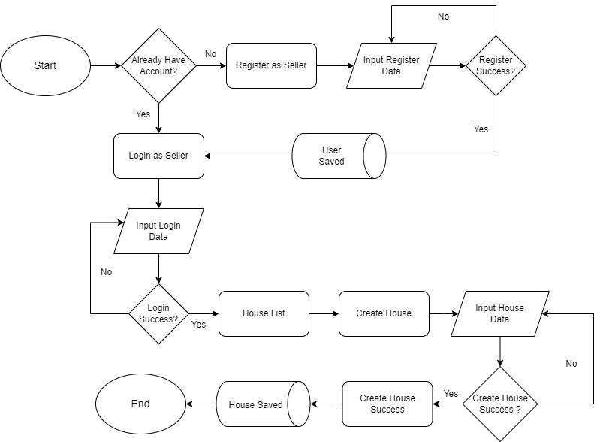
Seller
Flowchart
PHINCON PROPERTY

Slide 7
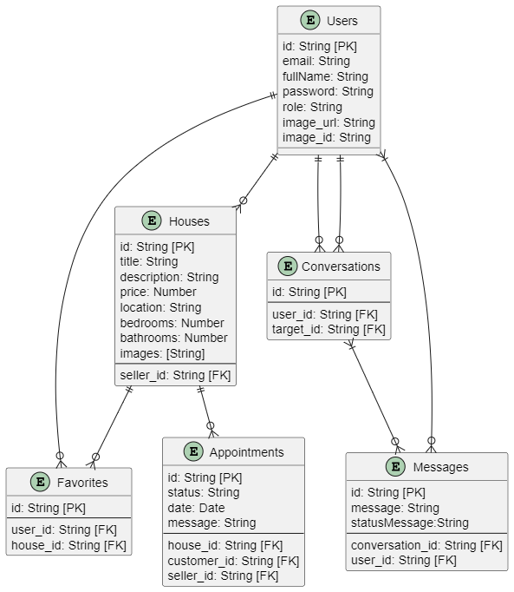
ENTITY
RELATIONSHIP
DIAGRAM
PHINCON PROPERTY

Slide 8
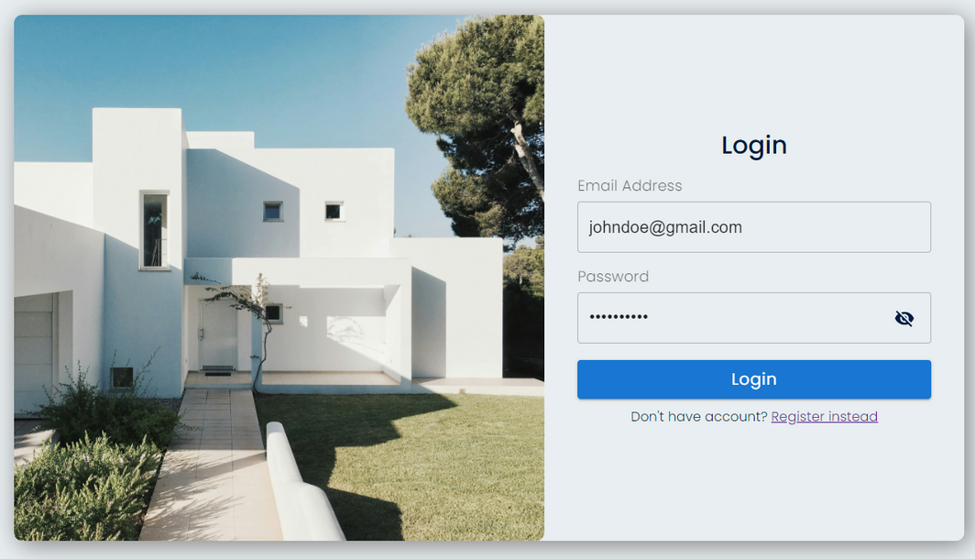
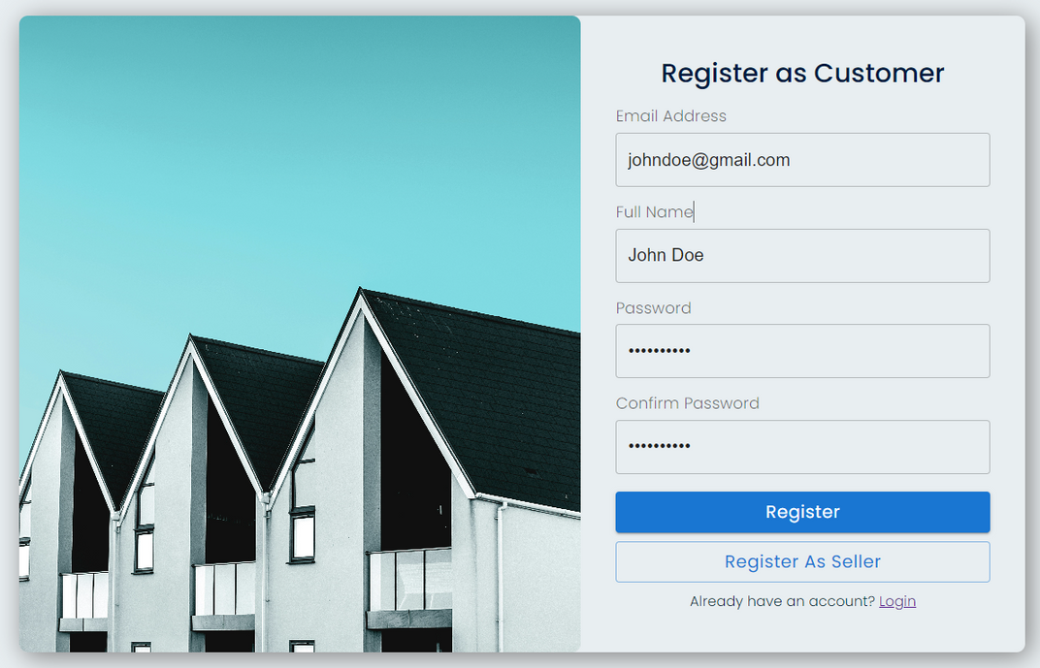
PHINCON PROPERTY
Register
Login

Slide 9

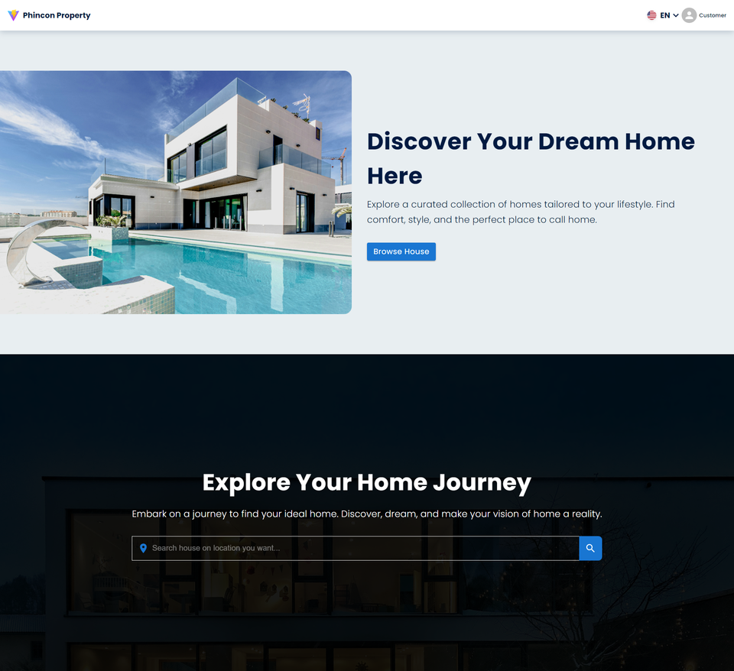
PHINCON PROPERTY
HOMEPAGE

Slide 10
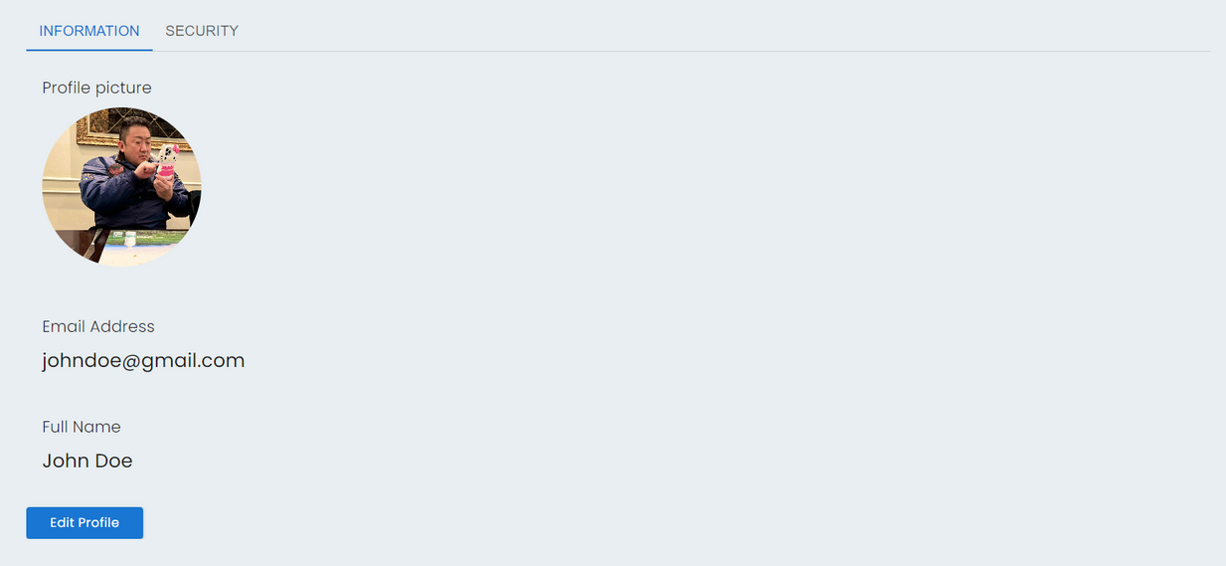
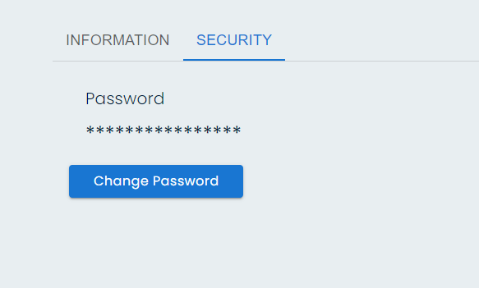
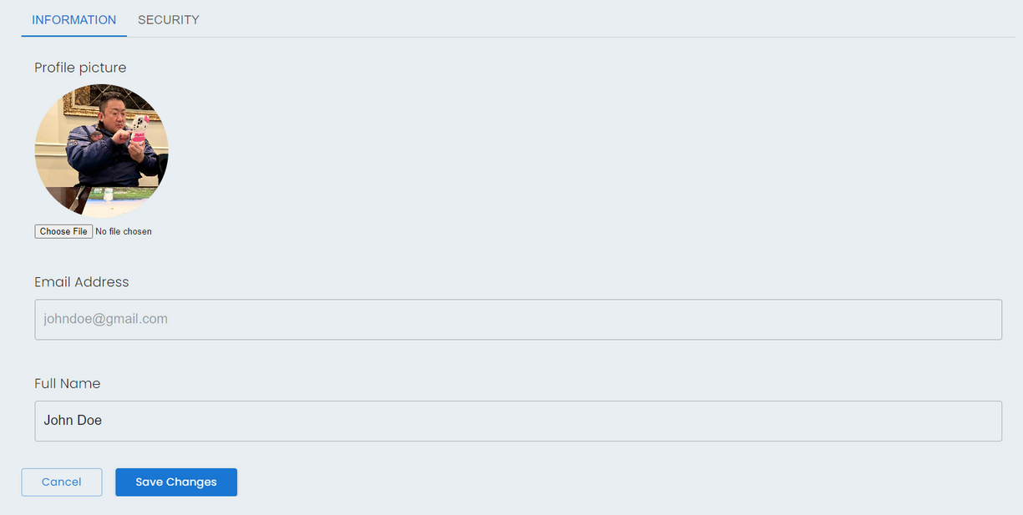
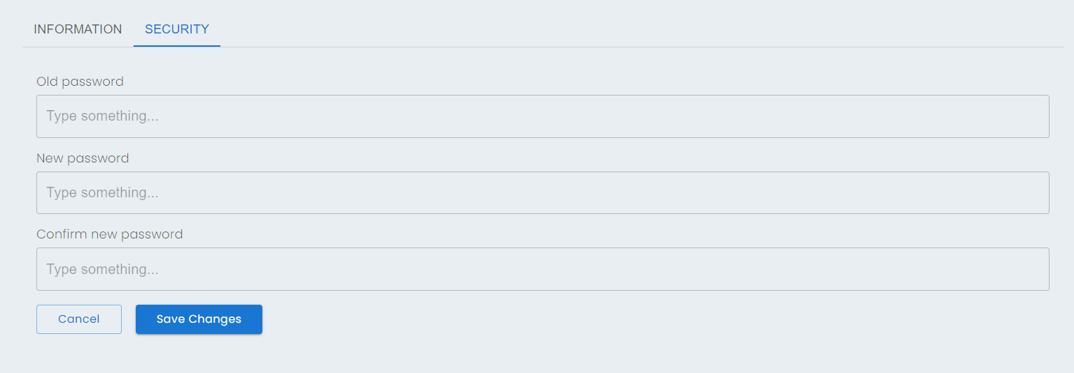
USER DETAIL
PHINCON PROPERTY

Slide 11
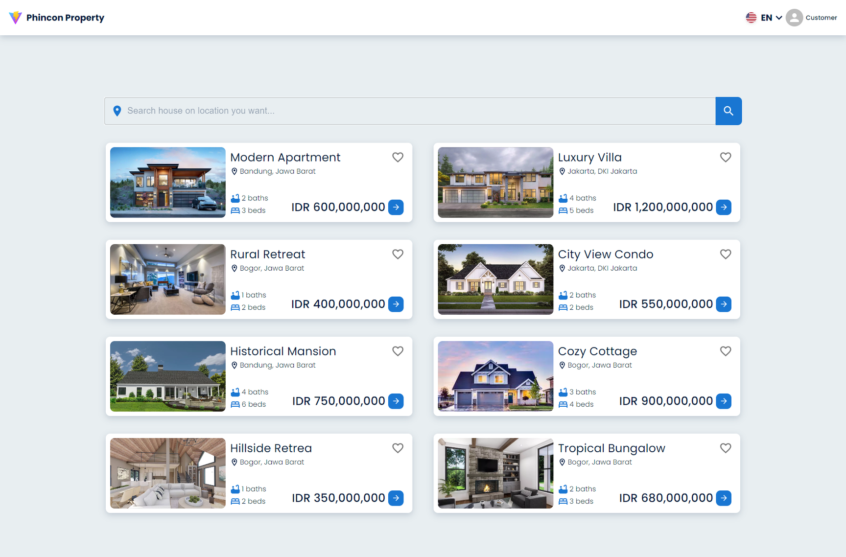
HOUSE LIST
PHINCON PROPERTY

Slide 12

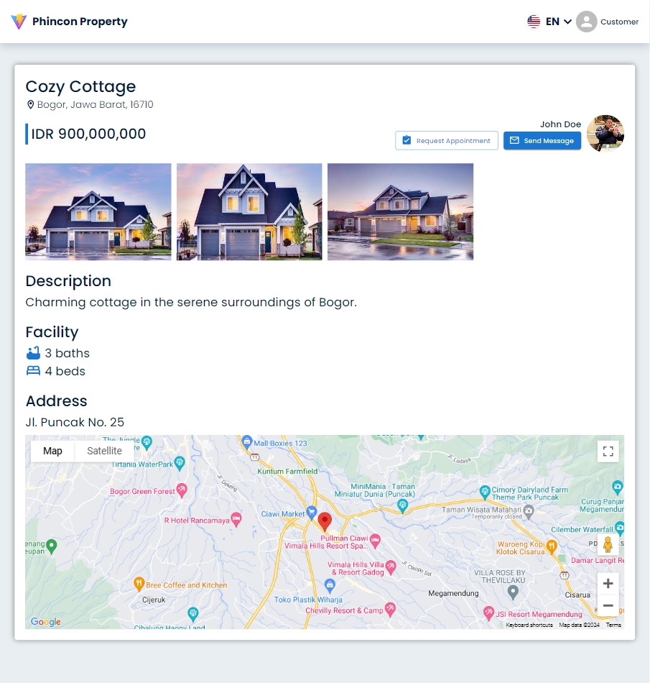
HOUSE
DETAIL
PHINCON PROPERTY

Slide 13
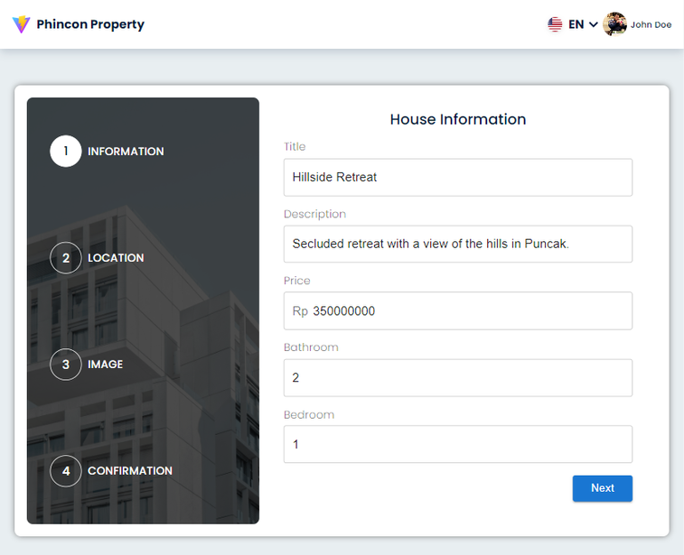
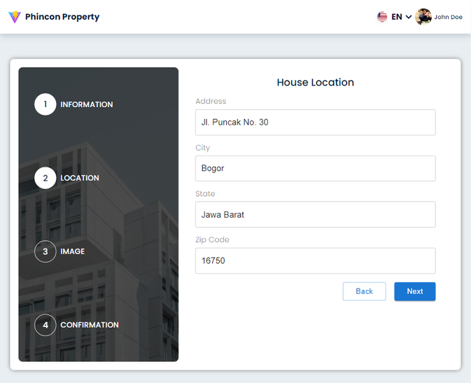
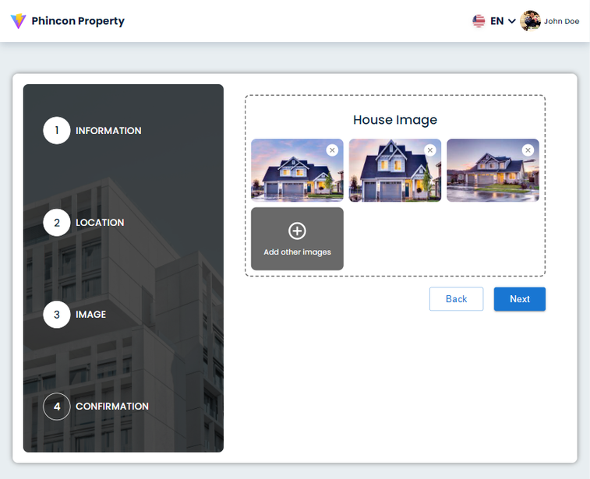
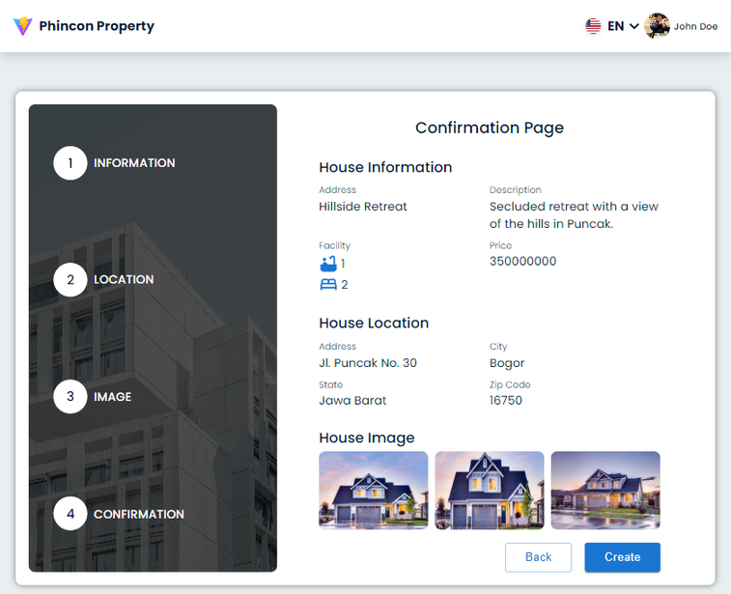
PHINCON PROPERTY
CREATE
HOUSE

Slide 14
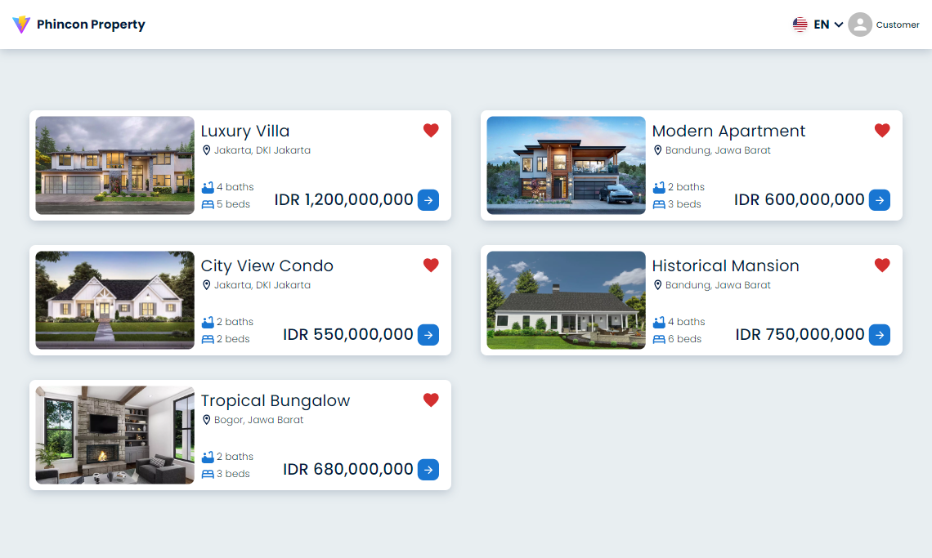
FAVORITE LIST
PHINCON PROPERTY

Slide 15
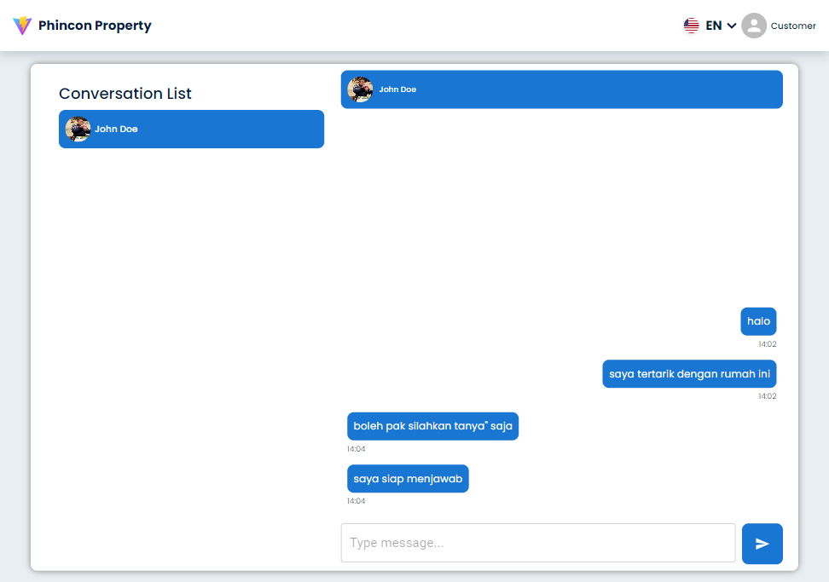
MESSAGE
PHINCON PROPERTY

Slide 16
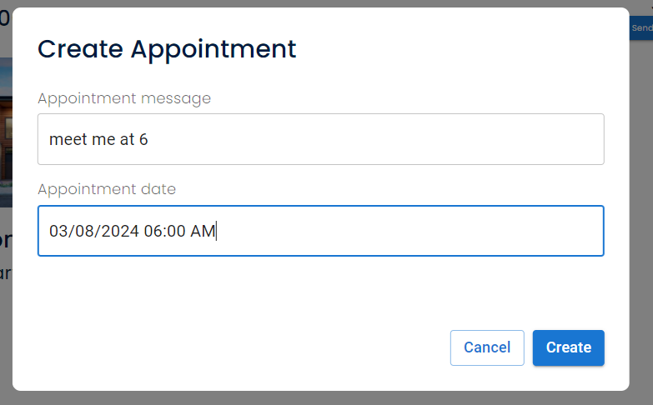
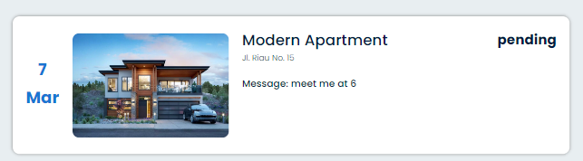
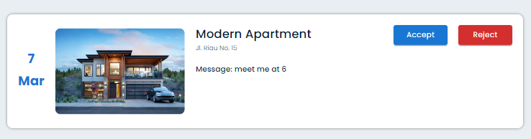
PHINCON PROPERTY
APPOINTMENT

Slide 17
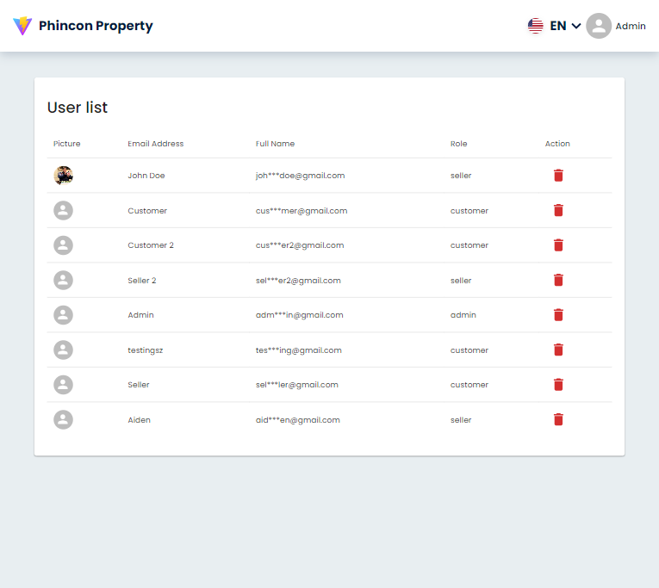
USER LIST
PHINCON PROPERTY

Slide 18

OBSTACLE
Time

Slide 19
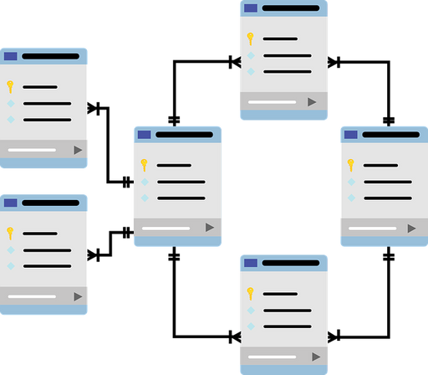


WEAKNESS
New Tech
Database Management
Feature and Task Planning

Slide 20




HANDLING WEAKNESSS
Documentation
Task Priority
Discussion

Slide 21


PLAN
Keep Learning about
Website Development
Teach Other About Website Development

Slide 22



SUGGESTION
WFO Shifting
Extend Daily Task
Deadline
More Group Project
PHINCON PROPERTY

Slide 23


